Slide 1
NON-NEGOTIABLES, APPLICATION STRATEGY,
& COVER LETTERS
Nicole Palidwor
Outcomes Career Coach

Slide 2
LEARNING OBJECTIVES
APPLICATION STRATEGY
Discuss what are must haves and do withouts in selecting a role
Label the 5 step application process
Determine best practices for composing a follow up message
Plan and implement a job search schedule
Develop a working cover letter template that properly represents their professional brand

Slide 3
APPLICATION STRATEGY
HOMEWORK

Slide 4
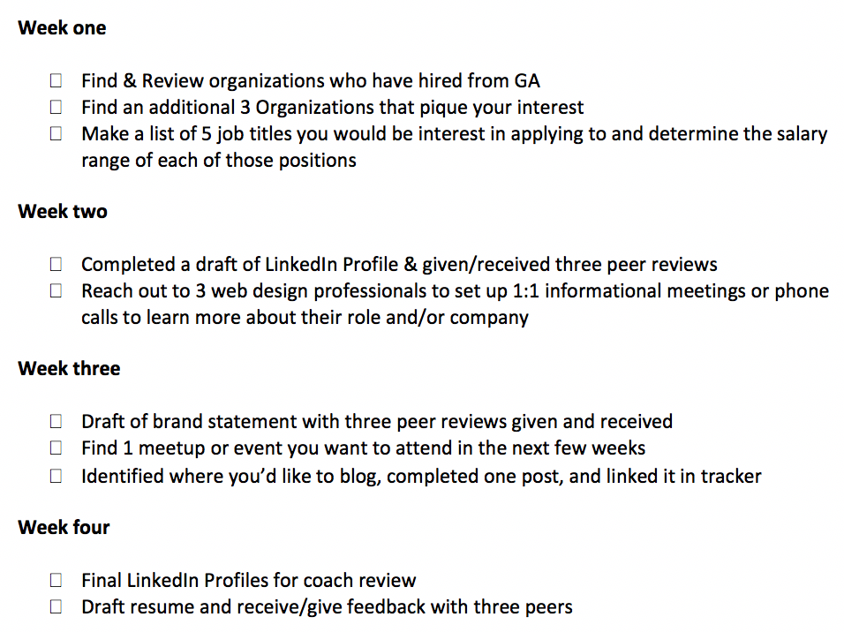
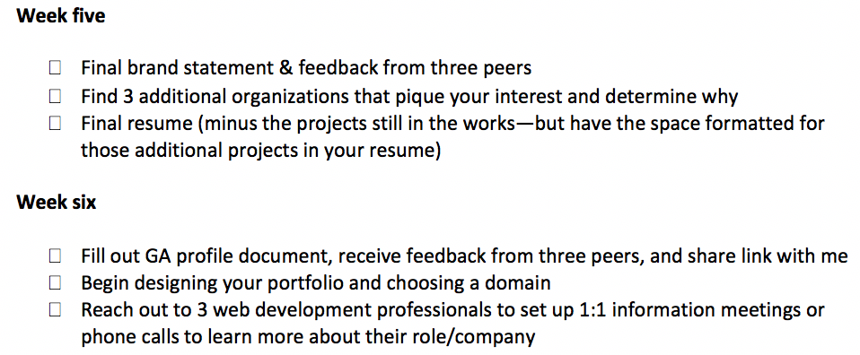
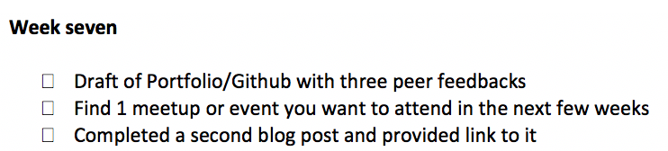
SHOULD BE DONE BY NOW

Slide 5
APPLICATION STRATEGY
THIS WEEK’S HOMEWORK

Slide 6
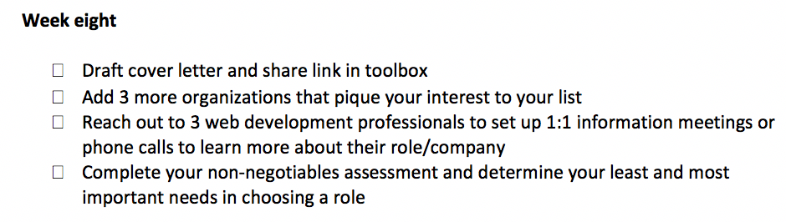
THIS WEEK’S HOMEWORK

Slide 7
APPLICATION STRATEGY
NON-NEGOTIABLES

Slide 8
NON-NEGOTIABLES
When you’re looking at a possible role, it is important to know what you absolutely need in a position, what you’re willing to compromise on, and what your overall job goals are.
By asking yourself the following list of questions, you can begin to identify your must haves in a role and the items you are willing to concede on.
Go through the following list and ask yourself these questions. Following them, rank your priorities in a role and your TOP THREE are your NON-NEGOTIABLES. Your BOTTOM THREE are the your lowest priorities in the role and will be the best areas to “trade on” when negotiating.
You can find the fill-in spreadsheet here.

Slide 9
NON-NEGOTIABLES
What industry do I want to be? What kind of role? Have I figured out the size of the company?
How important is it for me to be able to grow and evolve in a company? Did I need role changes or opportunities to move into a senior role to be satisfied at my company?
Is traveling full or part time an option? If so, how often and to what region(s)?
Are benefits important to me? What one’s are important and what may be optional? IE: health, dental vision, 401k matching
What style management do I need to be successful?
Trusts your skills: Minimal involvement, trust me to do my work will without constant supervision
Motivator/Support figure: Is involved in my work process and provides support and strategizing in your role
Expert: A guru on your position that provides meaningful support and suggestions
Idealistic: Knows the big picture and major goals but doesn’t mingle in the details of your role’s process

Slide 10
NON-NEGOTIABLES
How will this role impact my personal and family life? How will it affect my outside hobbies or interests?
What is my bare minimum to pay my existing bills and keep a reasonable budget? How much would I like to make to move ahead to pay for major life milestones like home ownership, having children, further education, retirement, etc.?
What is the company’s mission? Do I relate to it? How do my values align with it?
Is this a stepping stone role? Will it move my career forward or keep me in a similar position as to what I’m in now?
What will my work environment look like? Will it be casual in dress code and demeanour or more conservative and include things like ties, suits, slacks, etc.?

Slide 11
NON-NEGOTIABLES
What level of stress am I willing to take on to do the role successfully?
What do I want in a colleague environment? Do I want social, involved colleagues, or those that tend to keep to themselves? What kind of social environment am I looking for?
What type of company am I interested in? Size, type, industry, etc.?
How important is a specific title to me? Why is it important and what do I envision being the impact of the specific title on my career?
What do I want in an organization type? Non-profit, for-profit, privately held or publicly traded?
What service or product is the company providing? How does it align with my interests and/or values? Would I be a consumer of what the company markets or sells?
What kind of additional perks am I looking for in this position? Additional PTO, ping pong table, snacks, bonuses, etc.?

Slide 12
NON-NEGOTIABLES
What is my view on commuting? Length and time involved? How far will I commute for a better opportunity?
How important is work/life balance to me? What does that look like? How long can I sustain a difficult balance if I need to?
What type of work hours can I/am willing to keep?
What kind of flex time or remote work options do I want/need? What percent of my time do I want to have this as an option?
What type of work will make me feel appropriately accomplished based on my goals within a year, three years, and five years?
Am I looking to move into management roles or participate in leadership?
What role do I want to play in my coworkers’ day-to-day work? Mentorship, collaboration, or other?

Slide 13
NON-NEGOTIABLES
Review the following to accurately complete the activity on the next slide:
Organization Type - Non-profit or for-profit
Company Type - Agency, corporation, small business, start up
Location - Places you are willing and unwilling to work
Commute - How long of a distance you’ll commit to getting to work
Salary - The bare minimum you need for survival as well as your goal salary
Benefits - 401K, health/dental insurance, PTO, child care stipend, etc.
Perks - Gym pass, discounts for certain companies, parking stipend,remote work, etc.
Coworkers - How important it is to be close and involved with colleagues
Product / Service - What the company is creating and offering the consumer
Environment - Independent, collaborative, well-resourced, entrepreneurial
Growth potential - Likelihood of moving into a higher-level position or more elaborate role
Title - Specific title upon hire and upon moving up in the organization
Mission - What the company stands by and models their business practices around
Hours - Hours you will keep at the office on a regular basis
Responsibilities - What your position actually entails on a day-to-day basis

Slide 14
NON-NEGOTIABLES
Now you’re going to rank the following from 1 to 15:
Organization Type _____
Company Type _____
Location _____
Commute _____
Salary _____
Benefits _____
Perks _____
Coworkers _____
Product / Service _____
Environment _____
Growth potential _____
Title _____
Mission _____
Hours _____
Responsibilities _____
Note:
The reason this list is so important is that when you approach negotiations for a potential position, you will need to know what you must absolutely have to have to be happy/successful at a company and what are areas that are less important and provide you negotiation “leeway”.

Slide 15
APPLICATION STRATEGY
HOW PEOPLE GET JOBS

Slide 16


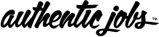

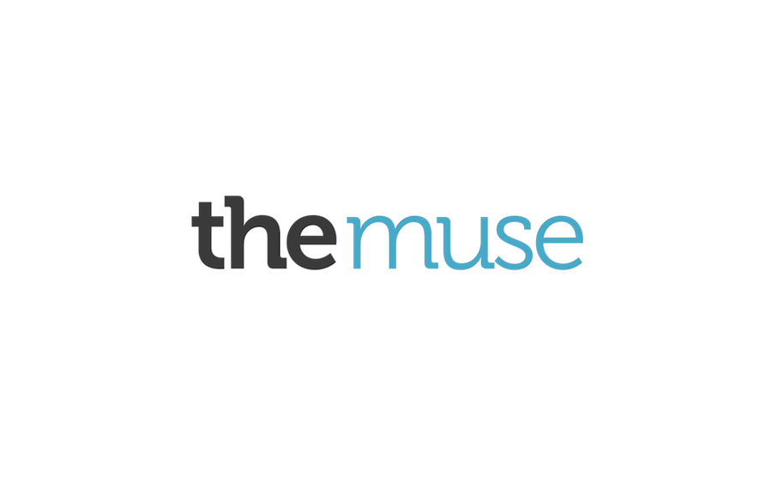


HOW PEOPLE GET JOBS
Job Boards - it’s a numbers game!
Angel.co
AuthenticJobs.com
Indeed.com
Glassdoor
LinkedIn
The Muse
Built in Colorado

Slide 17




HOW PEOPLE GET JOBS
A more effective way to get a job:
INTERVIEW
WITH A
COMPANY
NETWORKING
INFORMATIONAL
INTERVIEWS

Slide 18
HOW PEOPLE GET JOBS
FIND YOUR ALLIES!
LinkedIn = great resource = lots of information!
The Facts:
95% of companies use LinkedIn to search for and contact candidates
93% vet candidates pre-interview
92% post jobs to LinkedIn
Four step process:
1. Don’t make them a complete stranger.
2. Leverage your existing network.
3. Craft a friendly intro email/message
4. Follow up

Slide 19
HOW PEOPLE GET JOBS
Go to LinkedIn & start searching
Do you have connections at the company you’re interested in?
Can they provide you with more information or even refer you?
Use the search feature to find people at the company to reach out to directly.
Recruiter? HR?
Somebody in the role to which you’re applying?

Slide 20
APPLICATION STRATEGY
WORKING WITH EXTERNAL (AGENCY) RECRUITERS

Slide 21
HOW RECRUITERS WORK
They don’t work for you. They work for their clients.
A recruiter’s job is to find the best candidates for their client - the company who will pay them.
Recruiters simply facilitate the process by introducing you and preparing you to meet their clients.
Recruiters are usually not involved in hiring decisions & don’t have much input in the decision.

Slide 22
HOW RECRUITERS WORK
PROS CONS
-Faster search (maybe) -Opportunities not the right fit
-Opportunity to explore options -Confidential searches
-Interview practice -Recruiter may be unresponsive
-Feedback from recruiter -Less room for negotiation
Agencies Specializing in Dev/UX/Creative/Data:
Creative Circle, Vitamin T, The Creative Group
Luna Data Solutions, M&P, Robert Half, TEK Systems

Slide 23
APPLICATION STRATEGY
AFTER YOU FIND A POSITION OF INTEREST

Slide 24
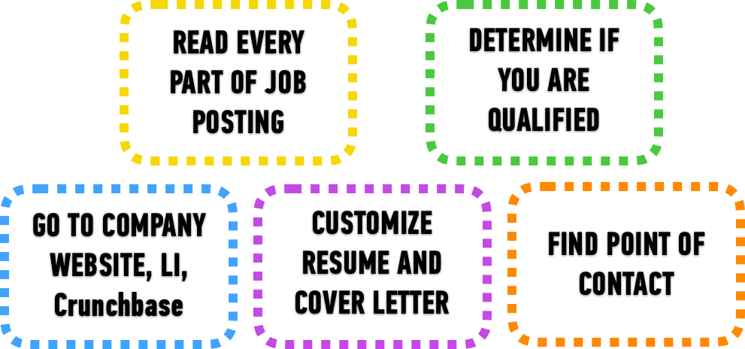





AFTER YOU FIND A JOB OF INTEREST
Notes:
When I ask you where you are with a particular job, you can tell me and you have confidence in knowing what the step they are in job search process.

Slide 25
AFTER YOU FIND A JOB OF INTEREST
Let’s walk through the first two steps together!

Slide 26
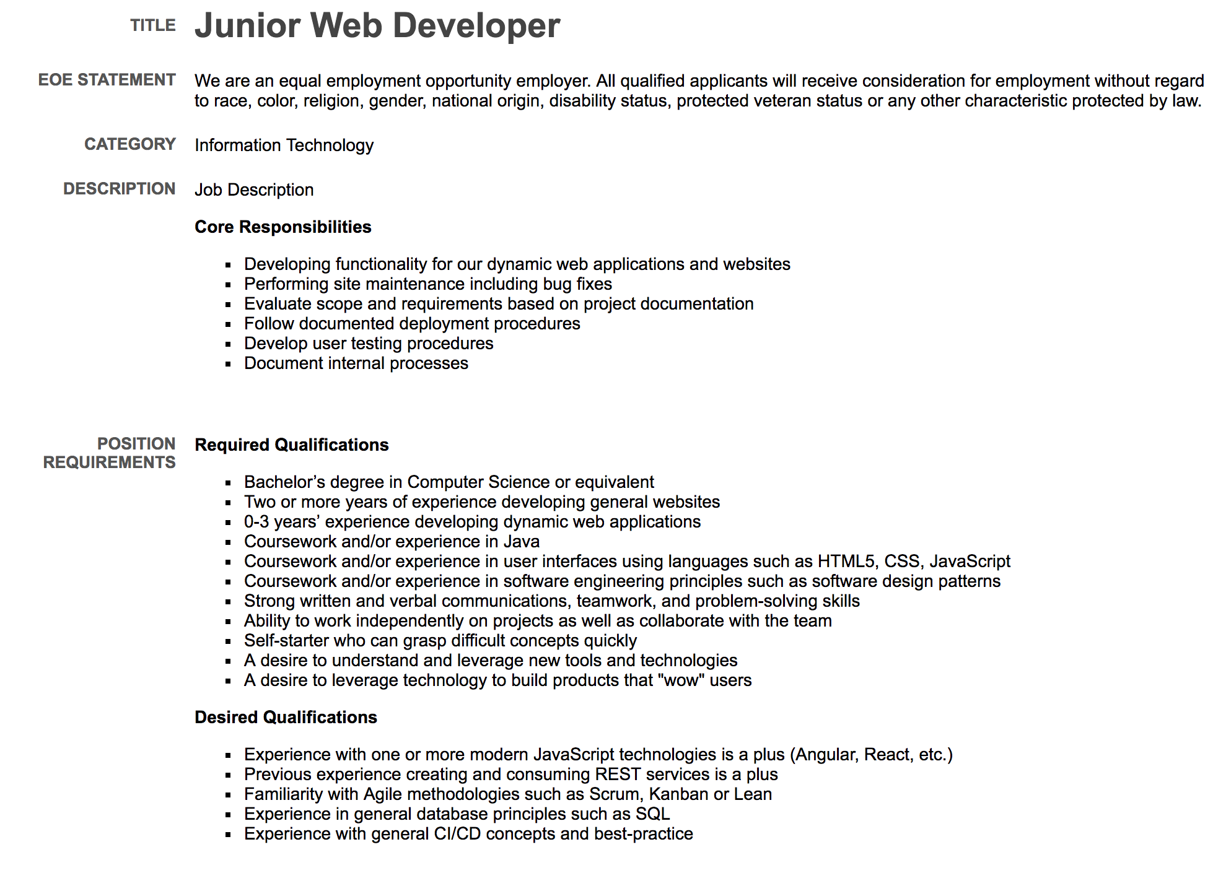
AFTER YOU FIND A JOB OF INTEREST

Slide 27
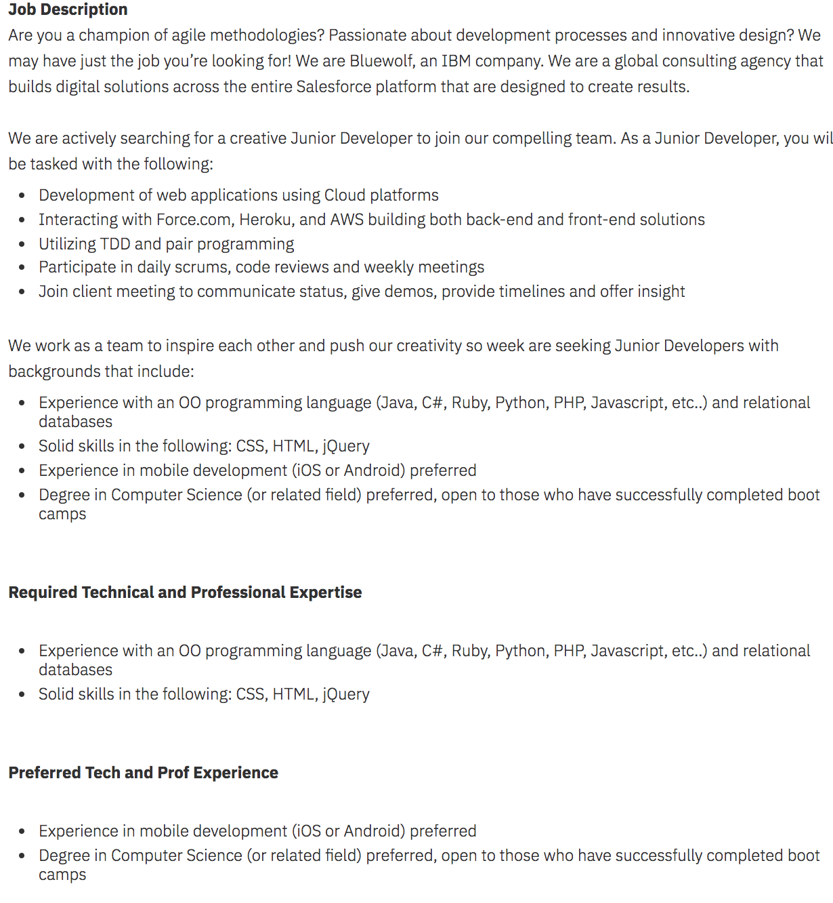
AFTER YOU FIND A JOB OF INTEREST

Slide 28
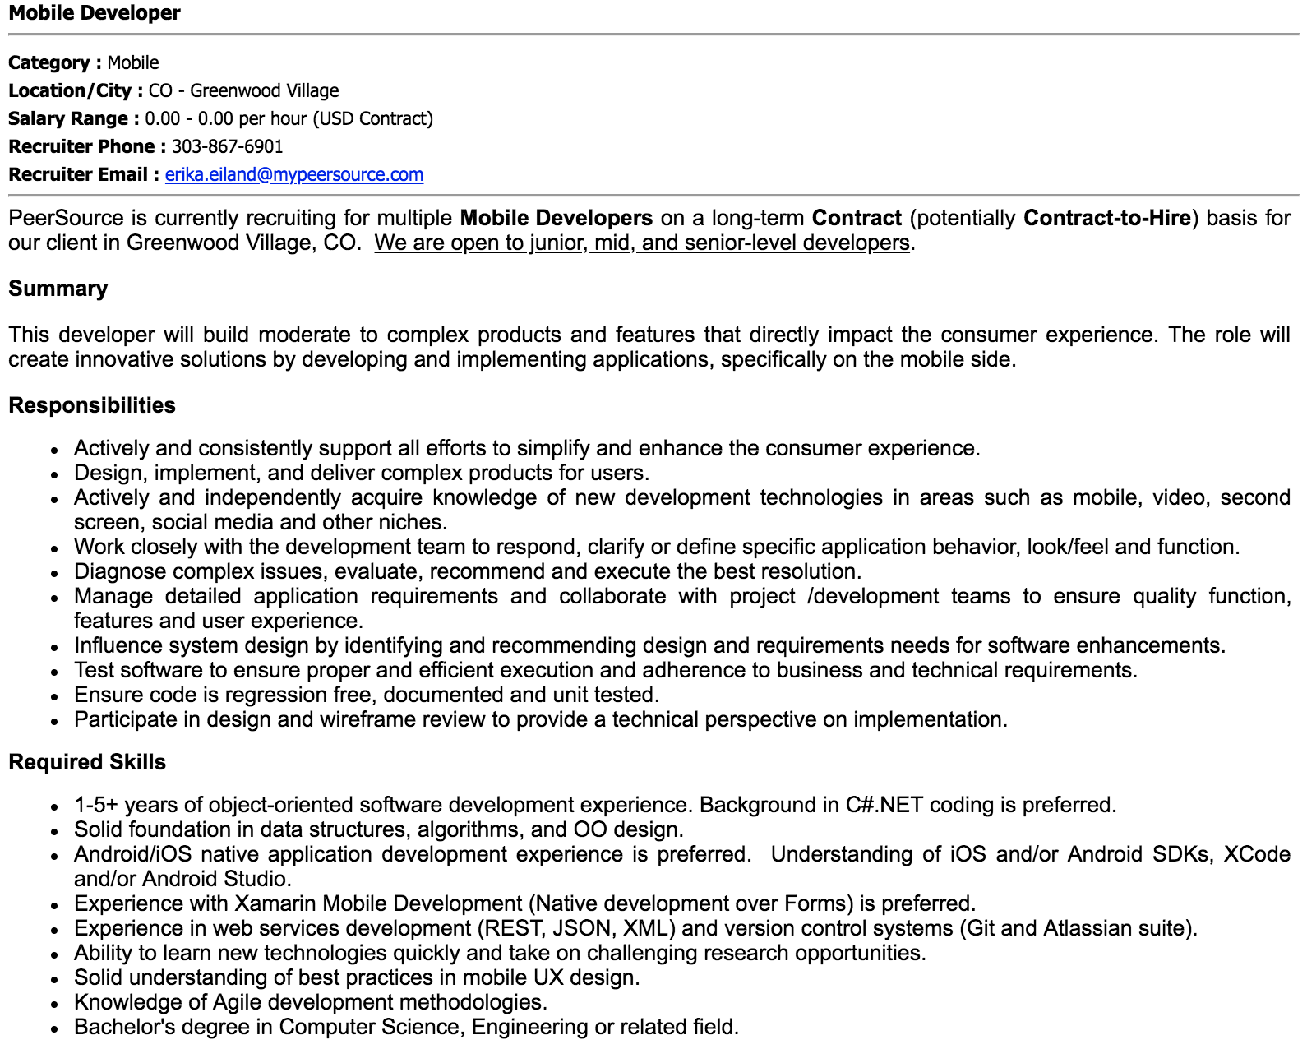
AFTER YOU FIND A JOB OF INTEREST

Slide 29
APPLICATION STRATEGY
WHEN IT COMES TO APPLYING FOR A JOB...

Slide 30
APPLYING
If you’re emailing someone directly, your cover letter is the body of your email and your resume is attached as a PDF or Word document.
If you’re applying online, your cover letter is included in one of the following three ways:
Attached to the site as a PDF. [Joe Smith Cover Letter.pdf or .doc]
Combined with your resume as one attachment and uploaded to the site as one file. [Joe Smith Cover Letter + Resume.pdf or.doc]
Pasted into a text box on the website.

Slide 31
APPLICATION STRATEGY
REACHING OUT

Slide 32
REACHING OUT
Once you apply, don’t wait for them to come to you.
Use LinkedIn to find a connection (web developer or recruiter or both) at that company that you can reach out to for more information.

Slide 33
REACHING OUT
First sentence: Intro - Why you are reaching out
Second sentence: Compliment something specific about person or company that signifies why you are interested.
Third sentence: Acknowledge you understand they are busy and ask their advice (people love this). Suggest meeting for coffee if this is someone you would want to meet with. Close with thank you.
Most importantly, talk like a person in your message. Don’t be too formal. If you can make a connection to an interest, project, or past experience outside of GA, even better!

Slide 34
REACHING OUT: WHAT NOT TO SAY
[SUBJECT] Regarding New Opportunities - Recent graduate
Hello,
Hope you are doing well. I am XYZ, a graduate student majoring in computer science from New York University. I am graduating this May and actively looking for full time opportunities. Being a graduate student from computer science background and having a number of leadership positions, I am interested in choosing the career path of software developer.
I look forward to the possibility of hearing back from you. Please feel free to contact me at your convenience by phone or via email. Thanks for your time and consideration. You can find my resume here:

Slide 35
REACHING OUT: WHAT TO SAY
[SUBJECT] Curious about your company!
Greetings!
Hope you are well. My name is ___ and I am currently transition my career to focus solely on data as a web developer, software engineer, etc.
I see you are a [title] at [company] and I am looking to connect with professionals like you to learn more about the industry and the work you’re doing.
I'm sure you're busy, but I would love to buy you a cup of coffee and connect. What does the week of [x] look like for you?
I look forward to hearing from you soon!

Slide 36
WHAT TO SAY: TO A RECRUITER
Greetings!
I hope you are well! My name is ___ and I am currently transitioning my career to focus solely on development as a [web developer/software engineer/front end developer/back end developer/etc].
I applied online on [date] and am following up as I am very excited at the thought of joining such an amazing organization. [Insert 1-3 sentences about your background and why that makes you a fit for the role. Think about using bits from your cover letter here. If possible, find a way to provide them a service in return--learn what type of recruiting the recruiter does and mention potential referrals you could also bring them.]
I know you are incredibly busy, but if you have any questions or would like to set up a time to chat, please reach out via my [insert email here] as I would love to talk further about such an amazing opportunity and hear any insight you might have.
[Your name]

Slide 37
REACHING OUT: QUESTIONS TO ASK THOSE YOU CONNECT WITH
Example Informational Interview Questions:
Tell me about a typical day - what do you do and who do you work with?
What do you enjoy most about your job?
What makes your job difficult?
How did you find out about the job in the first place?
What is your educational & career background? Have you found it useful in your current job?
Did you have the skills you have now when you first started?
What are the most important abilities you think someone needs to do your job well?
What do you think would prepare someone for your type of work?
What are your favorite meetups or groups in town?
What trends do you see in the industry?
What advice do you have for someone new to this industry?
Can you think of anyone else I should talk to?

Slide 38

ACTIVITY: 5 STEP APPLICATION PROCESS
DIRECTIONS
EXERCISE
Write down the five step application process on your desk or paper.

Slide 39
APPLICATION STRATEGY
COVER LETTERS

Slide 40
COVER LETTERS
Do you really need to write cover letters? YES! And here’s why:
Not many people write them, so you already appear to be an overachiever who will go above and beyond.
In a cover letter, you can explain with more depth, who you are and why you’re the best candidate.
Your resume displays what you’ve done & where you’ve done it, the cover letter, tell who you are and why you’re the best person for a specific job with a specific company.

Slide 41
COVER LETTER FACTS
A cover letter is like a spare tire...there in case you need it.
A cover letter is an introduction to your resume.
It is the only thing that separates the the person from being a candidate and being a human being. Anything that sets you apart from other candidates is an absolute must.
Most (~85%) hiring managers do not read them, yet about more than half (53%) admit they prefer candidates who send a cover letter.

Slide 42
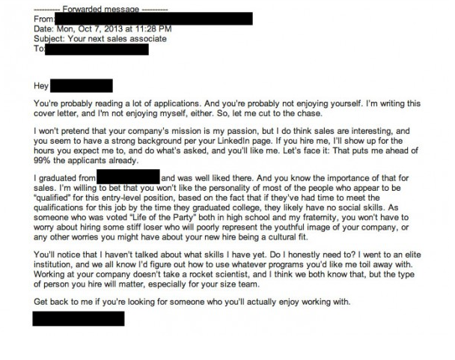
COVER LETTER EXAMPLE - BAD

Slide 43
APPLICATION STRATEGY
COVER LETTER FORMAT

Slide 44
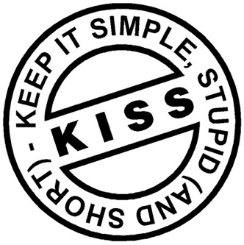

COVER LETTER FORMAT
CONTENT

Slide 45
COVER LETTER FORMAT
Use the same heading as your resume: Name, phone number, email, location (just city, state), link to portfolio
Paragraph 1: Say what you are applying for and how you heard about the organization.
Paragraph 2: State why THEY are great.
Paragraph 3: State why YOU are great.
Paragraph 4: State why you BOTH are great and would be a good fit.
Paragraph 5: Call to Action and Contact Info.

Slide 46
COVER LETTER FORMAT
Salutation
Good Morning or Good Afternoon
Opening Paragraph
Provide the reader with information about how you came to know about the position you are applying for. You may mention your source (internet, job board, or personal referral).
Middle Paragraph(s)
Mention 3-4 of your core qualifications which make you eligible for a specific position.
Mention information about your past experience, skills, and talent. It is recommended that you write information regarding your major accomplishments in this section as this will provide the reader with a solid reason to pick up your accompanying resume.
Closing Paragraph
Close in a way that the reader does not forget you! You must talk about your availability for interview, how you can be contacted and indicate your anticipation for a response.
Once you have signed off your cover letter, you must proofread it.

Slide 47
COVER LETTER FORMAT
Example:
Good Morning Mary,
I am excited to apply for the web development position. TravelClick has become a leader in the hospitality industry by always focusing on its clients—whether they’re huge global brands or local hotels. Your commitment to customer satisfaction is something I’ve always strived for in my own career. I’d love to bring this dedication, along with my relevant skills and experience, to your award-winning company.
Over the last few months, I’ve been developing my skills in the development industry and have developed more than 30 high-level features that incorporated client requests, development needs, and product team requirements within deadline and budget demands. Balancing so many needs was often challenging, and I learned how to find the solution that satisfies the maximum number of stakeholders. As your web developer, I’d apply this knowledge to ensure we delivered innovative solutions and experiences that work for our customers and their users while staying on-time and within budget.
Again, TravelClick focus on customer service has made a huge impression on me. I would be thrilled to work at an organization where every employee—from an intern to the CEO—cares so much about the people they help. If you have any questions or would like to set up a time to talk, please reach out. I look forward to hearing from you soon.
Thank you for your time,
Susy Sunshine

Slide 48
COVER LETTER FORMAT
Additional Example:
Good Morning [Hiring Manager / Company Name],
My name is [Your Name] and I am excited about the [role] opportunity at [Company Name]. I am particularly interested to work for a company and a team that is all about communication, collaboration, and the creation of innovative products that we can be proud of and fit the customer's needs. When I came across your job posting, I was immediately struck by the clear passion for technology, the value for creative thinking, and the respect for dedicated people.
For the last four-months I have been living and breathing development. Lots and lots of development. From the moment I logged on in the morning to the late afternoon -- I researched and developed all things development-- and I loved it! I loved learning each new piece in the process and enjoyed approaching each component as a fun puzzle to solve. Each item is another tool in my arsenal to solve problems and help clients get what they want in the best way possible.
I want a job where I can do this every day and work with a team who is united in creating the best possible product we can for our customers, to see them happy, and to be proud of what we did. I want to work for a company who seeks to provide their customers with what they need, not what we want and who values transparency and trust. I believe that company is [Company Name].
I hope that what I've said so far has peaked your interest. I welcome the opportunity to talk more as we have a lot in common and would love to work with a company that is so progressive, innovative, and passionate.
Thank you for your time,
<Name>

Slide 49
COVER LETTER TIPS
When writing a cover letter...
Keep it short and sweet (250 to 350 words).
Start with a salutation:
-Good Morning ACME Team
-Good Afternoon Mary
-No: To Whom It May Concern
Do include the hiring manager’s name. [Unless you don’t know it (then research to find it!)]

Slide 50
COVER LETTERS TIPS
Don’t regurgitate your resume. Choose career/skill highlights. Think numbers, KPIs, and measurables.
Think not what the company can you do for you but what you bring to the table. What makes your different from the other applicants?
Showcase your skills along with highlighting the right (i.e. applicable to the job you’re applying to) experience.
Start with a template. But don’t go too far like this guy...

Slide 51

COVER LETTER TIPS
Consider testimonials from former supervisors.
Cut the fluff. Be real, honest, genuine...and normal.
Don’t let your fear of bragging get in the way. Remember: it’s about confidence
Have someone gut check it--and edit and proofread it.
You need to edit and proofread it as well! The more eyes on it, the better.
Care most about standing out!

Slide 52
APPLICATION STRATEGY
ORGANIZING YOUR
JOB SEARCH

Slide 53
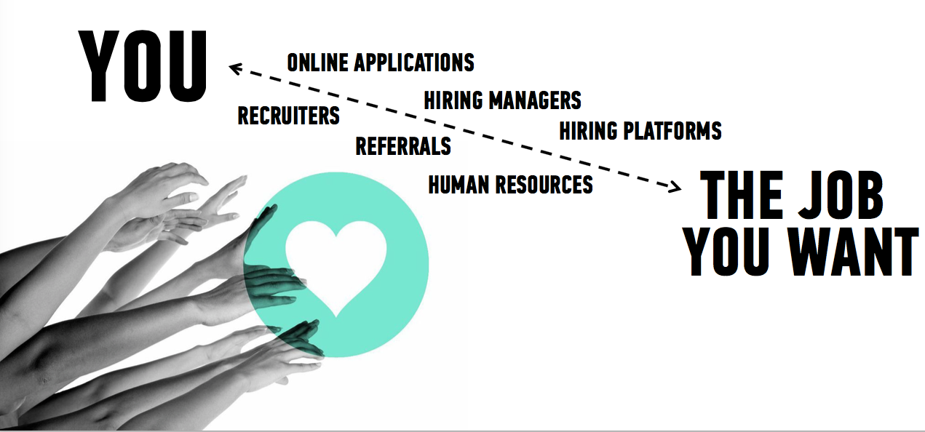
THE JOB SEARCH PROCESS

Slide 54
JOB SEARCH ORGANIZATION
Know what you’re searching for first
Research!
Do you have specific roles in mind?
Focus on searching those out first!
Do you have specific companies or industries in mind?
Here again, start your job search in a targeted manner and then expand as options potentially dwindle in your preferred companies
Also: know how to brand yourself for the particular company or industry
Banking & government are more traditional and buttoned-up
Startups & tech are more casual & relaxed

Slide 55

JOB SEARCH ORGANIZATION
Develop a system to track your search--you will use the
sheet that you included in the job tracker
Which companies have you applied to?
What is the status of my application?
Especially important for follow ups!
If you’ve applied and not heard anything, time for a follow up.
Your job tracker log will tell you where you’re getting stuck
Your log will also help you set weekly/monthly goals

Slide 56
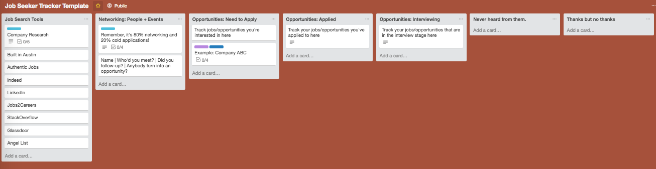

JOB SEARCH ORGANIZATION - ANOTHER TOOL

Slide 57
JOB SEARCH ORGANIZATION
Make a schedule & time block:
 | Monday | Tuesday | Wednesday | Thursday | Friday | Saturday | Sunday
9AM | Follow ups from last week | Review job boards | Apply to jobs (5) | 1:1 coffee meeting | Skill building activity | Work on projects | Sleep in
11AM | Message people to set up 1:1 coffee mtgs | Apply to jobs (5) | Skill building activity | Review job boards | Lunch meeting | Work on projects | Exercise
1PM | Work on projects / portfolio | Research companies | 1:1 coffee meeting | Apply to jobs (5) | Work on projects / portfolio | Go outside | Football
5PM | Exercise | Attend a meetup | Exercise | Attend a meetup | Dinner with friends | RELAX | RELAX

Slide 58
IN SUMMARY...
The responsibility to find a job is all yours, you’re the only one who can make your job search a priority.
How?
All the ways for all the days we discussed today!

Slide 59
APPLICATION STRATEGY
Q & A

Slide 60
APPLICATION STRATEGY
RESOURCES & CITATIONS

Slide 61
RESOURCES
COVER LETTERS
31 Attention-Grabbing Cover Letter Examples
How to Write a Cover Letter: 31 Tips You Need to Know
3 Quick Tricks to Make Writing a “Conversational” Cover Letter Easy
Cover Letters Are Hard to Write - But This Template Makes it a Breeze
Introducing: The Email Template That’ll Get You a Meeting With Anyone You Ask
This is What it Means to Write a Cover Letter for Your Resume
This Tiny Little Writing Fix Can Completely Change How Others Perceive You
3 Basic Email Mistakes That Make You Look Really Unprofessional
Even People Who Hate Writing Can Make Their Cover Letter Stand Out
I've Read Over 300+ Cover Letters and This Is How I Decide if It's Good or Bad Within 3 Minutes
How to Show You Get the Company Culture in Your Cover Letter
How to Write an Interview Thank-You Note: An Email Template
We Wrote 9 Awesome Email Templates So You Don't Have To
This is How You Write a Cold Email That’ll Get Your Foot In the Door
How to Write a Pain Point Cover Letter (Examples Included!)
5 Opening Lines That Are Straight Up Killing Your Cover Letter
5 Common Cover Letter Phrases That Are Losing You the Job
Blog.Mailtrack.IO: 7 Reasons Your Follow-Up Email Isn’t Effective
Motto: How to Make an Email Introduction That Doesn’t Ruin Both People’s Lives
50WaysToGetAJob: Applying for Jobs
Forbes: How to Write Your First Pain Letter
Uncubed: Why the Best Cover Letter is Customized

Slide 62
APPLICATION STRATEGY
HOMEWORK

Slide 63
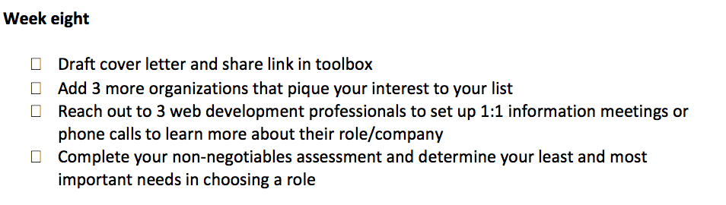
HOMEWORK

